Slide 1
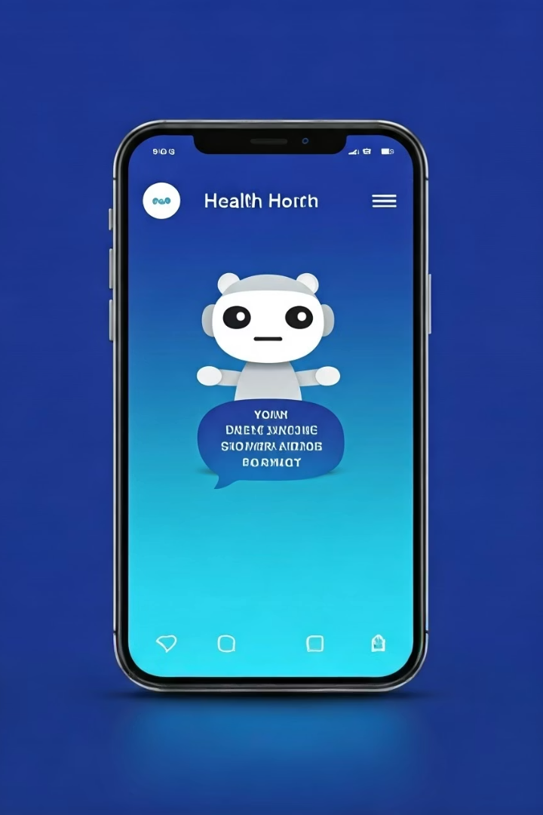
Health Resource Finder & Chatbot App
Introducing a health app that connects users with local services effortlessly.
Our chatbot, voice features, and booking tools enhance accessibility and convenience.

Slide 2

Project Objectives
Find Nearby Health Services
Accessible Interface
Chatbot, voice input, and speaker features aid users with different needs.
Use Google Maps API to show local providers and details.
Appointment & Reminders
Easy booking plus alarms to keep users on track with health appointments.

Slide 3

The Problems We Solve
Complex Service Search
Limited Accessibility
Missed Appointments
People with limited typing or vision need alternative input/output methods.
Users often forget bookings or appointments without timely reminders.
Users face difficulty locating nearby health resources quickly.

Slide 4
Understanding Our Users
Visually Impaired
Fatigue & Mobility Challenges
Busy Professionals
Need speaker feature for audio information and navigation.
Require quick access and reminders to manage health appointments.
Use microphone input to minimize typing efforts.

Slide 5





Innovation & Technical Excellence
Unique Chatbot
Intuitive interaction for diverse users, improving engagement.
Seamless API Integration
Google Maps API delivers accurate, real-time service data.
Advanced Accessibility
Voice input and output features address varied user needs.
Robust Codebase
Well-structured, maintainable, and efficient for smooth performance.

Slide 6



Relevance to Health Challenges
2
Inclusive Design
Enables users with disabilities to manage health independently.
Health Access
Bridges gap between users and vital health resources.
1
Prevention Support
Reminders reduce missed appointments, improving care continuity.
3

Slide 7

Next Steps & Impact
Launch Beta Testing
Collect user feedback to refine app experience.
Expand Health Listings
Include more services and improve data accuracy.
Promote Accessibility
Partner with organizations focused on disability inclusion.
Measure Impact
Track improved appointment adherence and user satisfaction.
Our app promises to enhance health engagement for vulnerable populations.

